Slide 1
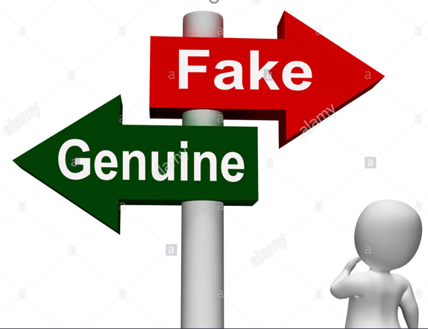
DATA MINING APPROACH TO DETERMINE FAKE/SPAMMER ACCOUNTS IN SOCIAL MEDIA
Course : MIS 637 –A ( Fall-2018)
Department : Information Systems
Prepared by : Suguna Bhargavi Bontha
Student Id : 10440658
Guided by : Prof. Mahmoud Daneshmand

Slide 2
INTRODUCTION:
Spammers on social media are fake users who use the medium for fraudulent purposes as follows:
Bulk messaging: In 2009, a spam website offering a job with Google tricked users to believe the site was genuine.
Spreading malicious links: When the link is clicked, activities triggered can range from downloading malware to stealing personal information.
Fraudulent reviews: These are reviews from users that never used the product. Various services usually pay users for positive reviews to boost their service offering.
Sharing undesired or excessive content such as insults, threats and unwanted advertising to genuine users.
Likejacking: Likejacking is the act of tricking users to post a Facebook status update for some site without their intent.
Early detection of such users can help in decreasing these criminal/fraudulent activities.

Slide 3
Table of Contents
Standard Process: CRISP-DM overview 4
Business Understanding 6
Data Understanding 7
Data Preparation 13
Modeling 18
Evaluation 31
Deployment 37
Conclusion 38
References 39

Slide 4
STANDARD PROCESS: CRISP-DM
CRISP-DM (Cross Industry Standard Process for Data Mining) is a data mining process model that describes commonly used approaches that data miners use to tackle problems. There are 6 phases:
1. Business Understanding:
  Determine the business objective.
  Assess the situation and determine the data mining goals.
  Produce a project plan.
2. Data Understanding:
  Collect initial data and describe it.
  Explore and verify the data quality.
3. Data Preparation:
  Select and clean the data from missing values and outliers
  Construct, integrate and format the data for analysis

Slide 5
STANDARD PROCESS: CRISP-DM (CONTINUED)
  4. Modeling:
    Select data modeling technique and generate test design.
    Build models and assess the model.
  5. Evaluation:
    Evaluate the results.
    Determine the next steps.
  6. Deployment:
    Plan the deployment.
    Plan monitoring and maintenance.
    Produce final report.

Slide 6
1. BUSINESS UNDERSTANDING:
What is the profound question?
Is a Facebook user account genuine or not, based on the various factors?
Example, we can study the content shared by the user and if its malicious then user can be claimed fraudulent or fake?
What is the goal?
To use data mining techniques like classification algorithms and to classify user accounts as genuine accounts and fake/spammer accounts and derive rules for the same.
What will be the accomplishments?
Today, security challenges are a major concern for users in many industries like telecom, banking and social networks etc. Malicious users seek to violate the privacy of other users and abuse their names and credentials . This study of fake and genuine accounts can help in prediction of the spammers and thus prevent crime/fraud.

Slide 7
2. DATA UNDERSTANDING:
Data Source:
The dataset was self-collected by a user for research purposes. Hidden account information was removed, so the data has the public information of accounts. The dataset comprises of personal information, post texts, photos and multimedia records of 889 users. Several users chose not to answer some of the questions because of privacy concerns but it is accepted.
The purpose of the study was to classify users as genuine users and fake/spammer users by applying Data Mining techniques, which can then be used in the future to diagnose malicious users at an early stage and thus decrease crime/fraud.
The data was obtained from https://www.kaggle.com/khahu132/fake-and-real-accouts-fakebook

Slide 8
DATA UNDERSTANDING (CONTINUED):
Data set details:
The dataset comprises of personal information, post texts, photos and multimedia records of a total of 889 users.
The data set has a total of 23 attributes, out of which 22 are independent attributes and 1 is the target attribute.
Out of these 23 attributes, 20 attributes will be used for modeling which are explained later in the slides.
The target attribute in this dataset is “Status” .It classifies whether the user is fake/spammer or not.

Slide 9
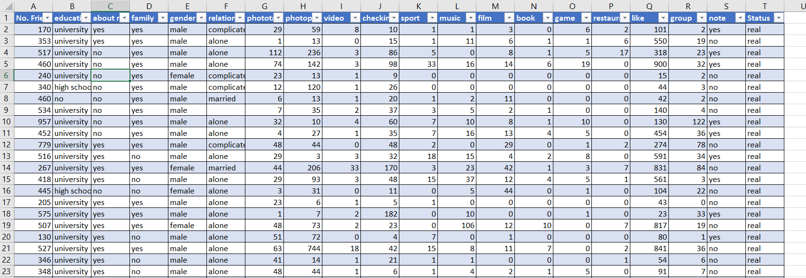
DATA UNDERSTANDING (CONTINUED):
Data set Sample:

Slide 10
DATA UNDERSTANDING (CONTINUED):
Attribute details:
1. No. Friend : Integer. Indicates the number of friends the user has.
2. education : String. User educational details.
3. about me : Boolean. Tells if the user has shared details about himself in public or not.
family : Boolean. Tells if user has shared details about family or not.
gender : Boolean. Male or female
relationship : String. Tells about relationship status of the user.

Slide 11
DATA UNDERSTANDING (CONTINUED):
7. phototag : Integer. Number of photos tagged in.
8. Photopost : Integer. Number of photos posted.
9. video : Integer. Number of videos posted.
10. checkin : Integer. Number of check-ins made at places visited.
11. sport : Integer. Number of sports liked.
12. music : Integer. Number of music albums/artists liked.
13. film : Integer. Number of favorite films watched.
14. Book : Integer. Number of favorite books read.

Slide 12
DATA UNDERSTANDING (CONTINUED):
15. game : Integer. List of the number of games of interest.
16. Restaurant : Integer. Number of restaurants visited.
17. like : Integer. This includes total likes of the user including films, tv programs, artists, books, sports, people and any area of the users interest.
18. group : Integer. Number of groups that the user is part of.
19. note : Boolean. Has the user written and shared any note or not.
20. Status :Boolean. This is the output variable. It tells if the Facebook user is genuine or not.

Slide 13
3. DATA PREPARATION:
For data preparation, the data set will be cleansed and transformed. The data set is reviewed for the following :
Handle missing values and outliers if any.
Look for attributes that might need transformation.
Select attributes that are appropriate for analysis.

Slide 14
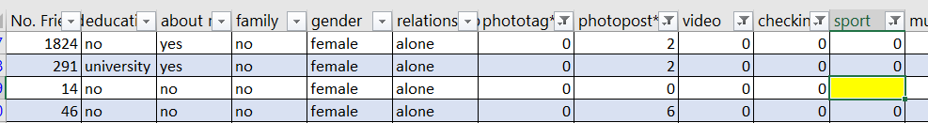
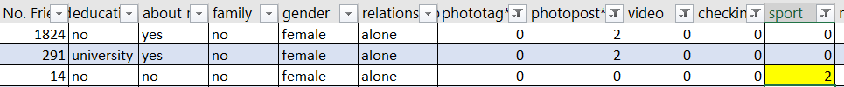
DATA PREPARATION (CONTINUED):
Handling missing values:
The data set has few missing values for the attribute “Sport” as highlighted below.
The attribute “Sport” is a numeric field. So we will replace the missing values with the mean of the non missing values for this attribute which is 2.

Slide 15
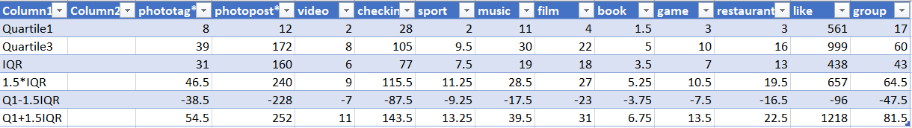
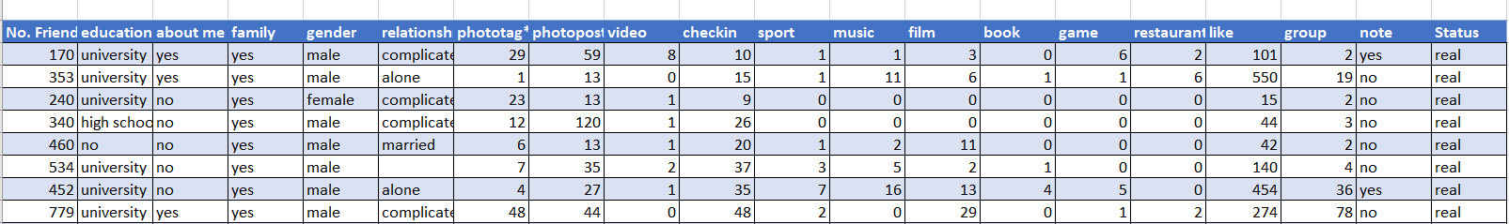
DATA PREPARATION (CONTINUED):
Identifying Outliers:
Outliers were identified using the IQR calculated as above and the records were removed. The new prepared dataset is as follows:

Slide 16
DATA PREPARATION (CONTINUED):
Selecting relevant attributes for analysis:
The data set consists of 23 independent attributes as mentioned previously.
Of the above 23, 20 attributes seem to be equally important in determining the dependent attribute .The 20 attributes have been discussed in data understanding slides .The output/target attribute is “Status” (which classifies the user as spammer or genuine).

Slide 17
DATA PREPARATION (CONTINUED):
Data division:
The previously shown data set consisting of 858 records is treated for outliers and missing values. After removing records containing outliers, we have 658 records now.
Training data set is used to develop the model. 70% of the data is used in this set i.e. 478 records are used.
Testing data set is used to evaluate the model developed using the training data set. 30% data is used in this set i.e. the remaining 180 records are used in this set.

Slide 18
4. MODELING:
The next step is to select the appropriate modeling technique. We will use one of the machine learning algorithms for our case.
Why Machine Learning Algorithms?
ML derives rules from data.
It takes the selected data and finds the relationship between dependent and independent variables.
Using ML, the relationship can be described as a decision tree, a rule, a chart, or an equation.
ML Algorithms answer the question: “What is the pattern that matches this data?”

Slide 19
MODELING (CONTINUED):
Which ML Technique?
The main objective here is to classify Facebook user accounts into genuine users and fake/spammer accounts and derive rules for the same.
So the approach of Recursive Partitioning best fits here since it splits the data into finer and finer subsets(recursively) resulting in a decision tree.
Also, since the target variable is categorical (real- real account/fake- spammer account) and is not continuous, Classification Tree is the right choice.
Hence, the CART Algorithm seems to be an appropriate choice for this problem. CART recursively partitions the data into subsets with similar value of target variable.

Slide 20
MODELING (CONTINUED):
Which Software Tool ?
CART® software is a robust,
easy-to-use decision tree tool
that automatically sifts large,
complex databases, searching
for and isolating significant patterns and relationships.
CART® can quickly reveal important data relationships that could remain hidden using other analytical tools.
Salford Systems offers a fully functional evaluation version of the CART® software with a free 30 day evaluation unlock code.
I will use the CART® software provided by Salford Predictive Miner.
Site reference: www.salford-systems.com

Slide 21
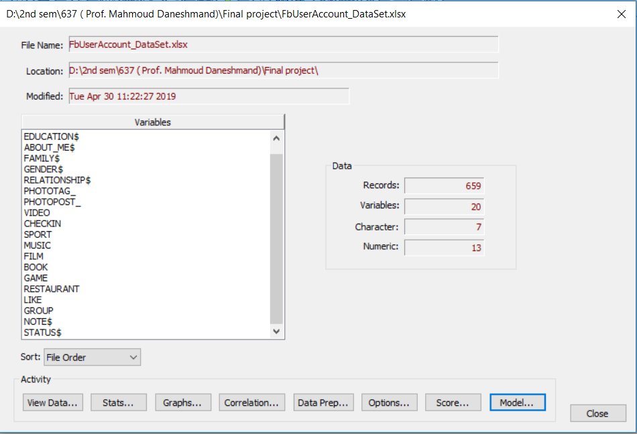
MODELING (CONTINUED):
Selecting the file containing the training data set to generate the model:

Slide 22
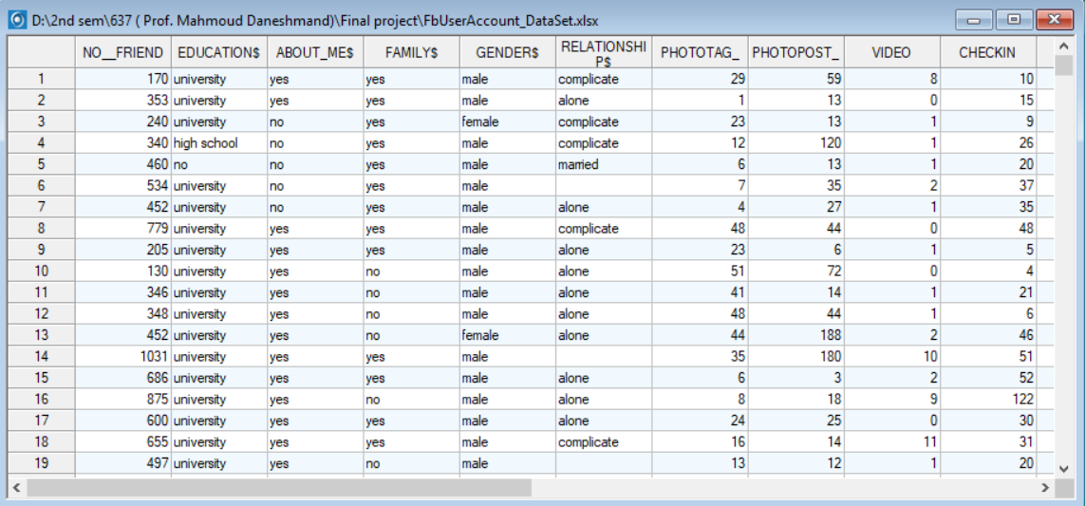
MODELING (CONTINUED):
Viewing the data file:

Slide 23
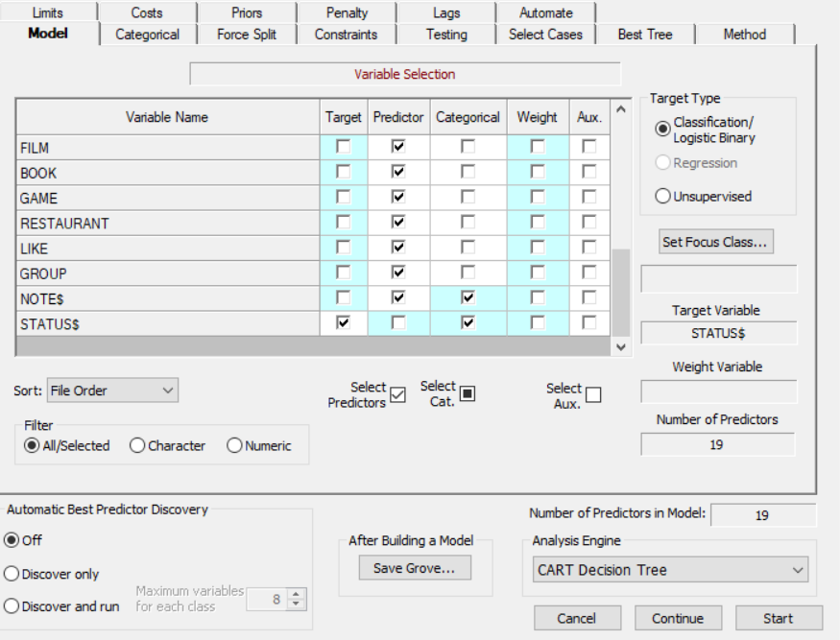
MODELING: EXECUTION USING CART®
Setting up the model:
Select the target variable and the predictor variables and after the model is set, we can begin the CART analysis by clicking on start. This will generate the decision tree.

Slide 24
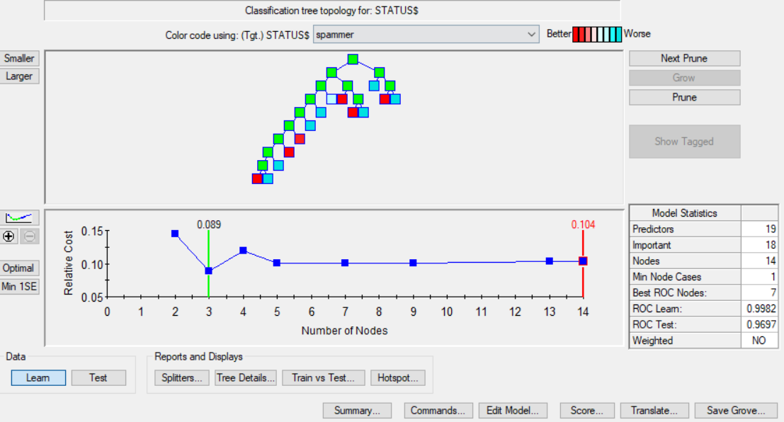
MODELING: EXECUTION USING CART®
Classification tree topology for target variable:
This is the view of the optimal tree which has the best performance. Number of nodes in the tree equal to 14.

Slide 25
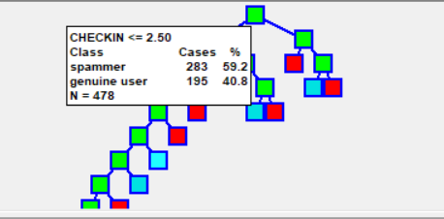
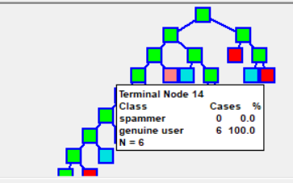
MODELING (CONTINUED):
Viewing node details:
Figure on the left represents the details of the root node.
Viewing the details, we note that we started with 283 spammer accounts (status = fake) and 195 genuine user accounts (status = real) as the first split on the total of 478 records. And the first split occurred for attribute CHECKIN.
Figure on the right represents the details of one of the terminal nodes.
This node has a genuine user account rate of 100% and has a node population of 6.

Slide 26
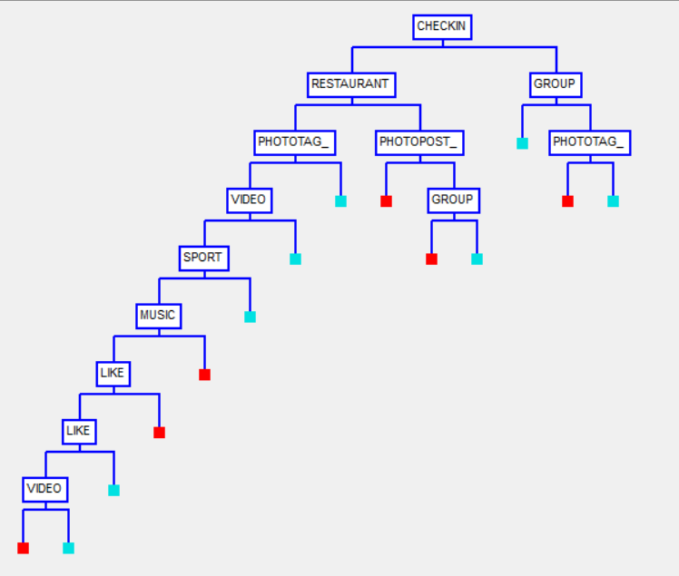
MODELING (CONTINUED):
Viewing the main splitters:
This view highlights the attributes that were used at each level for splitting. Color coding here is simplified with red indicating spammer Facebook user accounts and blue indicating genuine Facebook user patients.

Slide 27
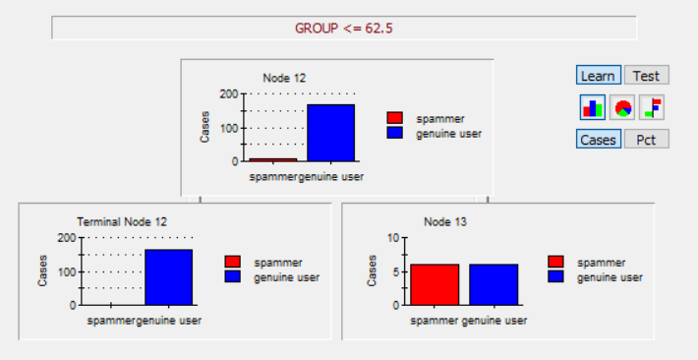
MODELING (CONTINUED):
Exploring sub trees:
Figure below represents sub tree for Node 12. As we see the split for this node occurs on attribute “GROUP” which finally result in 1 terminal node and 1 decision node. Terminal node 12 consisting of genuine user accounts and node 13 holds both spammer and genuine user accounts.

Slide 28
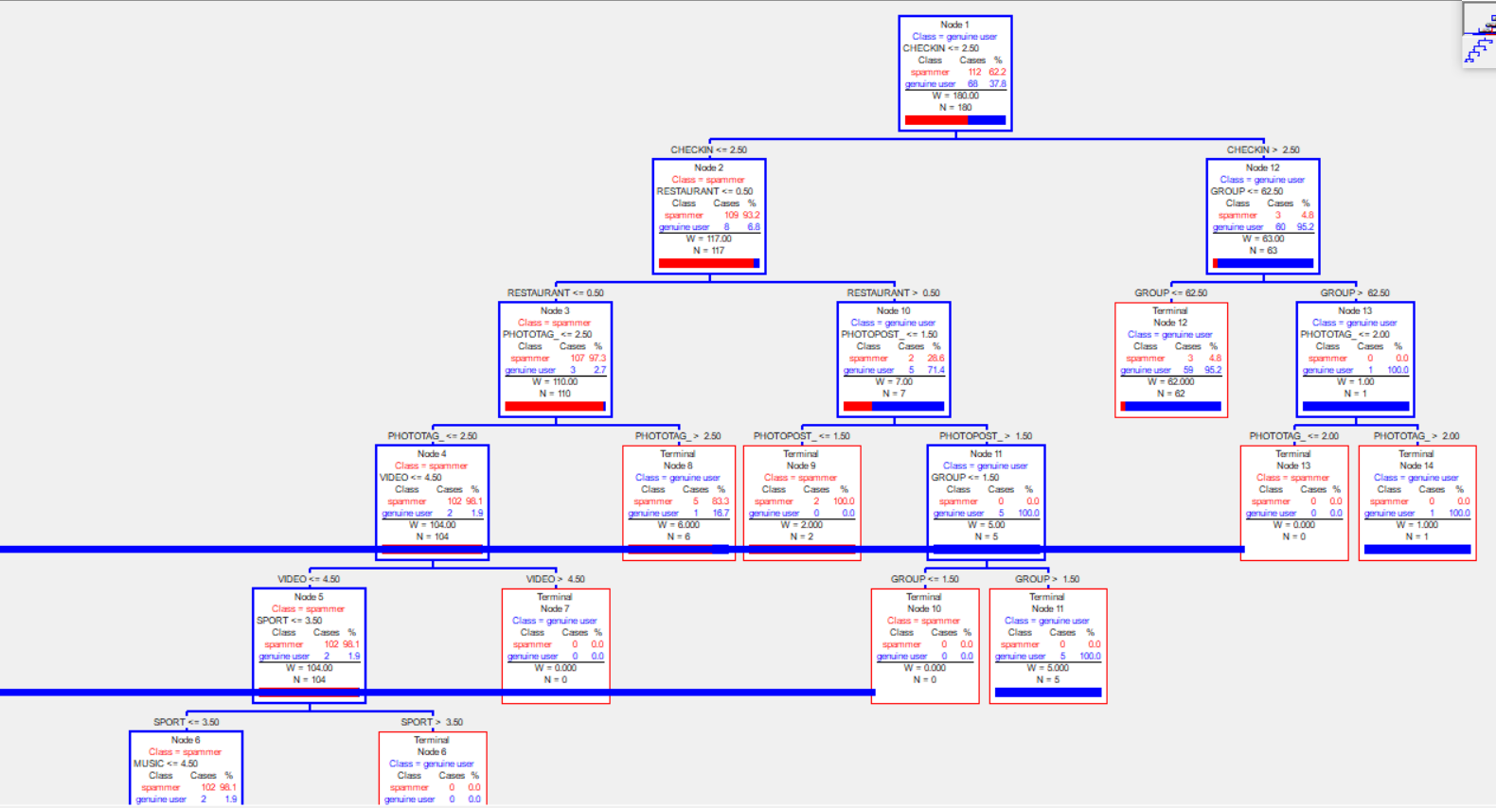
MODELING (CONTINUED):
We can see the split details for each node in one consolidated report.
A snippet is as shown below:

Slide 29
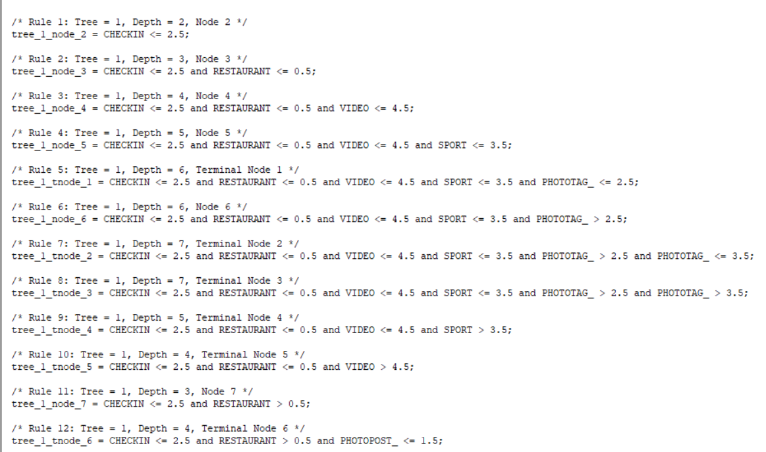
MODELING (CONTINUED):
Complete set of Decision Rules:

Slide 30
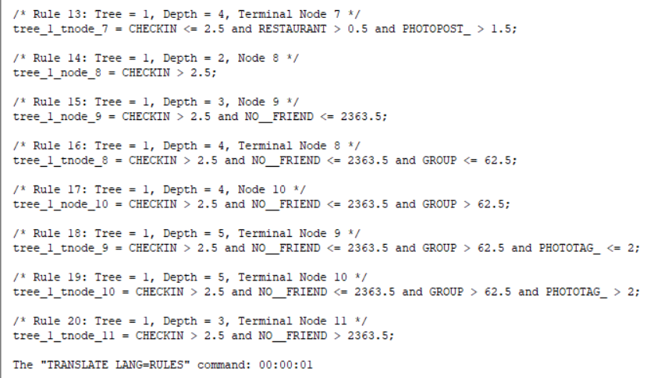
MODELING (CONTINUED):
Decision Rules (Continued):

Slide 31
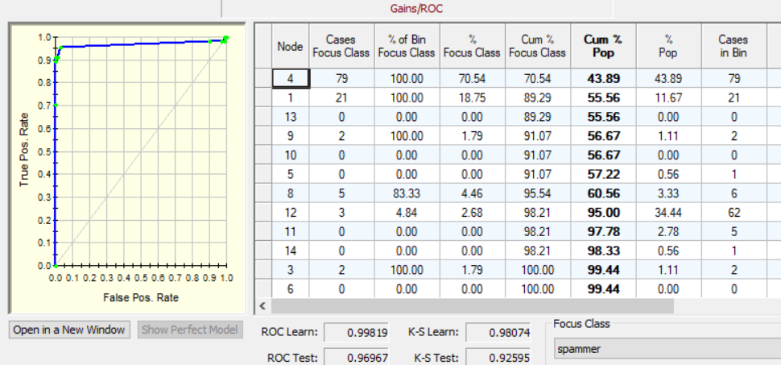
5. EVALUATION:
Gains Chart: The area between the baseline and the curve is high so this is a very good model.

Slide 32
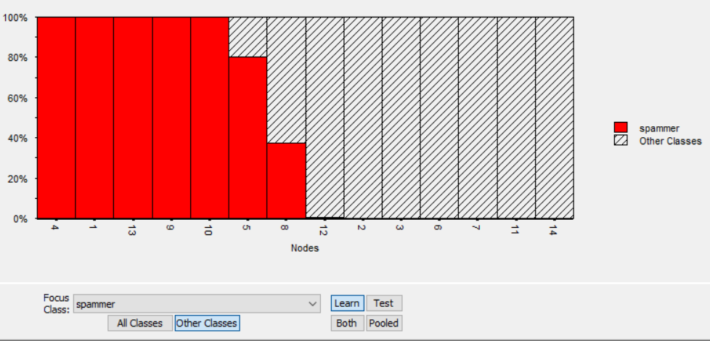
EVALUATION (CONTINUED):
Terminal Nodes Report:
This report shows the ability of the tree’s terminal nodes to capture the spammer user accounts. We see that users that classify under node 4,1,13,9 and node 10 are most surely fake users.

Slide 33
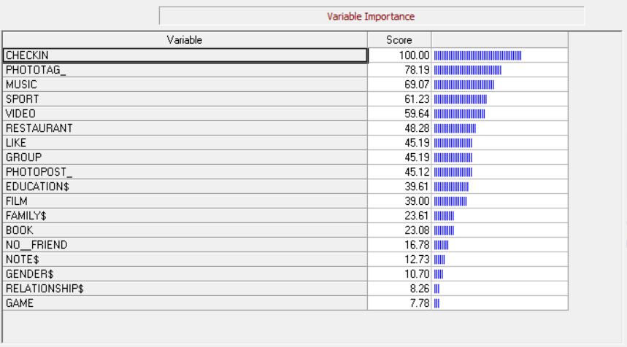
EVALUATION (CONTINUED):
Variable importance: The attributes in order of their importance for classification are listed below:

Slide 34
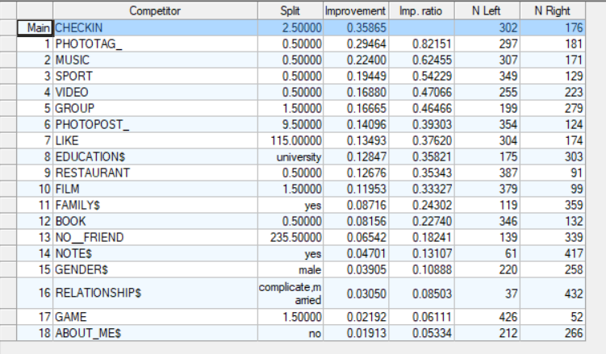
EVALUATION (CONTINUED):
Root Splits:
The root splits lists all root node competitors sorted in descending order. It also displays split details in terms of case count.

Slide 35
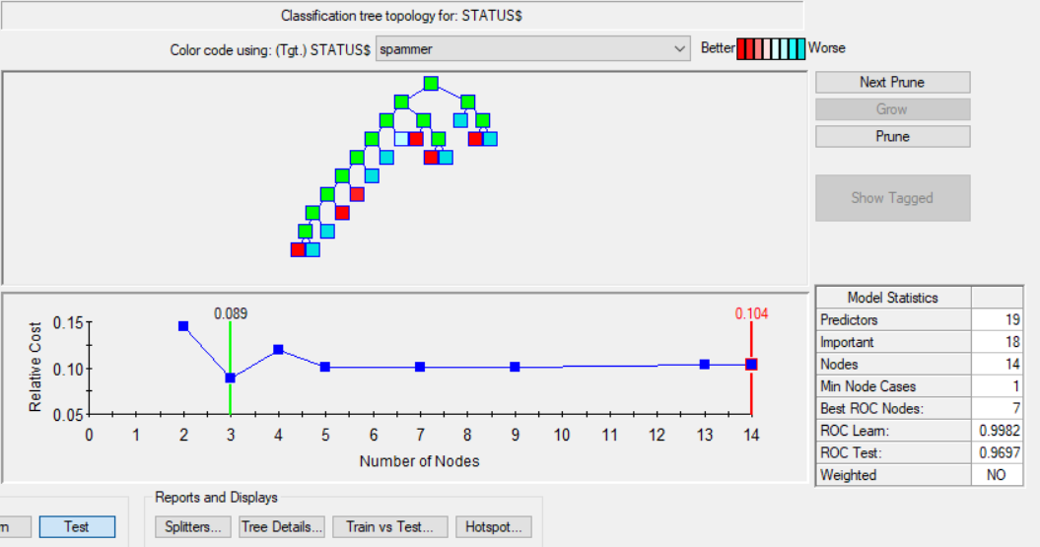
EVALUATION (CONTINUED):
Testing the model on test data: We see that the ROC test is 96% (slightly lower than the ROC learn of 99%) but 96% test ROC still shows the model is good.

Slide 36
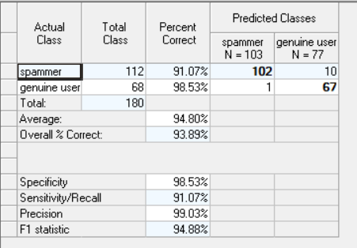
EVALUATION (CONTINUED):
Prediction success of the model:
The result shows that model has achieved average of 94.80% prediction success rate which is very good.

Slide 37
6. DEPLOYMENT:
This is the final phase of the CRISP-DM process. Here we will use the model created and perform deployment.
After evaluating the results obtained from the model in the previous phase, deployment would be executed on a small set of data to ensure success of model.
Simple report of results will be provided and the results will be checked to verify success. The deliverables will be compared against the expected goal as discussed during the business understanding phase.
Finally the model execution instructions will be provided to the Facebook organization, who can now utilize this model to identify spammer user accounts from genuine user accounts. This will in turn help in early detection of fraud and thus can help in taking relevant actions early.

Slide 38
CONCLUSION:
The results show that the model achieved an average prediction
success rate of 98.40%. This means the model has 98.40% chance of been correct in identifying a Facebook spammer user . This percentage shows good performance for the model.
Also we see that out of the 19 independent attributes, there are 18 attributes that play a major role in classifying the cervical patients. All attributes in the data set except the attribute “ABOUT_ME” are important for the classification.
Finally, the performance of the model can be further optimized by using combination of different algorithms and can be used by the fraud detection industries, and help in reducing the crime.

Slide 39
REFERENCES:
Discovering Knowledge in Data: An Introduction to Data Mining, By Daniel T. Larose
http://www.minitab.com/uploadedFiles/Content/Products/SPM/IntroCART.pdf
Lecture Notes and Slides
www.salford-systems.com

Slide 40
Thank You!

